Slide 1

PROJECT
To create a dynamic and responsive Java full stack web application for ERP system for college management.

Slide 2
Team Members
Employee ID | Name
2496193 | Sirapangi Keerthy Evangeline
2499315 | Akhil R U
2498799 | Gorava Devendra
2498316 | Shubham Kumar
2499017 | Thukanti Naveen
2498747 | Banothu Veeranna
2499321 | J.Naveen
2499017 | Dakarpu Sahitya
2497275 | Kumar Souvik Saha
2498489 | S R Aishwarya

Slide 3
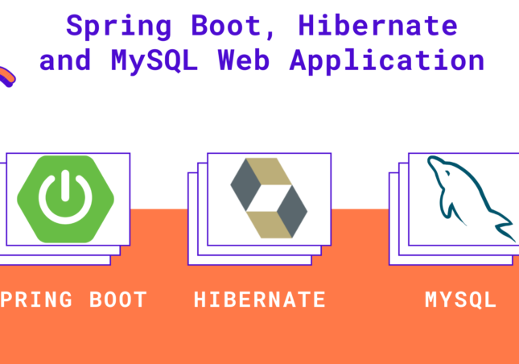
Tools and Technologies used
•Front-End: Angular
•Server-side: Spring Boot.
•Back-end: MYSQL, Hibernate.
•Server: Tomcat

Slide 4
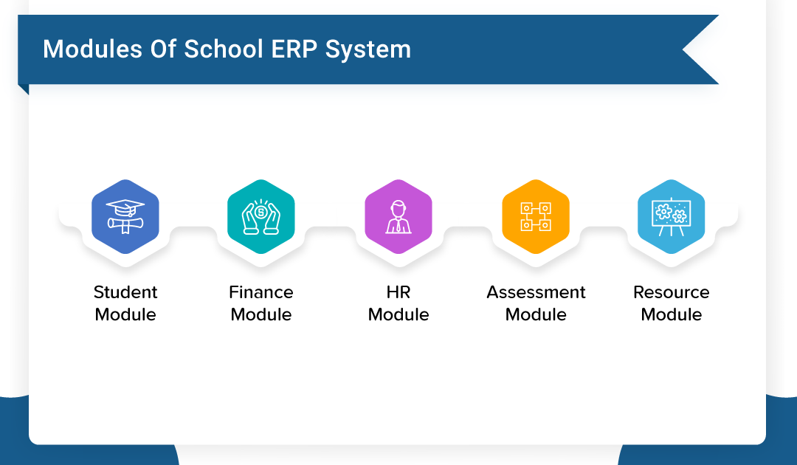
Background of the Project
ERP School/college/university Management Module which is used by Schools as well as Colleges to manage their daily activities which include the management of Employees, Students, Books and Library Records, Parents details, Assignments, Admission Process, Results and Reports, Exams, Events, Attendance, Timetable, Fees and Other Reports. It provides one-point access to manage these wide range of activities both effectively and efficiently. Managing a school, university, college , or any educational institution without a perfect software solution in the present times is painful, same in the case of any enterprises or business. Hence an appropriate solution is required which can ensure the smooth functioning of the organization, and with ERP college Management Module, this problem can simply be solved . As a result, the team decided to hire a Full Stack developer who could develop a “Online Bus Booking System” with a rich and user-friendly interface. You are hired as the Full Stack Java developer and are asked to develop the web application . The management team has provided you with the requirements and their business model so that you can easily arrange different components of the application.

Slide 5
Functional Requirements
1.Home Page -This page is the welcoming page of administrator after logging into the system.
2.Management of Employees
3.Management of Students
4.Management of Books and Library Records,
5.Management of Parents details, Assignments,
6.Management of Admission Process, Results and Reports, Exams
7.Management of Exams, Events, Attendance, Timetable, Fees and Other Reports.

Slide 6
Project Flow Diagram
3.Database Management
1.Agile Planning
5.Frontend
2.Project delivery divided into sprints
6.Testing
4.Backend

Slide 7
User Portal Features(A)
Below are the key functionalities to be implemented in the user portal .This user portal is for students.
Students should be able to:
Register or log in to the application to maintain a record of activities.
To check the time tables or scheduled classes.
Should be able to check the results and reports.
Should be able to check the dates of events and other reports.
Should be able to check about available books and library records.

Slide 8
User portal features(B)
Below are the key functionalities to be implemented in Parent’s user portal.
Parent’s should be able to:
Register or log into the application to maintain or check the record of activities.
To check about the management of admission process.
To check the results and reports of the students.
To check the details of exams and events scheduled.

Slide 9
User portal features(C)
Below are the functionalities to be implemented in employee’s user portal.
Employee’s should be able to:
Register or log in to the application to maintain a record of activities.
To check and maintain records about attendance.
To upload the timetable for scheduled classes.

Slide 10
Output for Module-1
1.Home page – This page is a welcoming page for administrator after logging into the system.

Slide 11
2.Management of Employees
DBMS Table
ID | CONTACT | DEPT | E-MAIL | NAME | ROLE
1 | 9088356756 | IT | sinha12@gmail.com | Sinha T | Senior Analyst
2 | 9083776756

Slide 12
3.Management of students
DBMS Table
ID | BATCH | CONTACT | DEPARTMENT | E-MAIL | NAME
1 | BA | 9083776756 | ROBOTICS | mouli143@gmail.com | MOULI N
2 | MA | 6361054879 | CIVIL | naveen123@gmail.com | NAVEEN J

Slide 13
4.Management of books and library records
ID | AUTHOR | NAME | PRICE
1 | R.Reddy | Mathematics | 300
2 | Srivasan J | Data Algorithm | 800
Books Table
Book Request Table

Slide 14
5.Management of Parent’s details and assignments.
Parent’s Details Table
ID | DATE | NAME | SUBJECT
1 | 22-04-2022 | TINA | Communication Engineering
2 | 20-05-2022 | SANDY | Mathematics Engineering
Assignments Table

Slide 15
6.Management of admission process ,results , reports and exams.
ID | Contact | Course | E-mail | Fee | Name
101 | 8906698761 | MCA | sandy@gmail.com | 10000 | Sandy
102 | 8920097541 | BCA | tina8@gmail.com | 35000 | Tina
ID | COURSE | NAME | RESULTS | SUBJECT
1 | MCA | SANDY | FAIL | DATA ANALYSIS
2 | BCA | TINA | PASS | DATA SCIENCE
Admission Table
Result Table
Admission Table
ID | COURSE | DATE | NAME | SUBJECT
1 | BCA | 19-05-2022 | TINA | DATA SCIENCE
2 | MCA | 29-05-2021 | SANDY | DATA STRUCTURE
ID | COURSE | NAME | PERCENTAGE
1001 | MCA | SANDY | 79
1002 | MCA | TINA | 89
Report Table
Exam Table

Slide 16
7.Management of exams , events, attendance time table fees and other reports.
ID | DATE | NAME
101 | 20-07-2022 | Fresher Party
102 | 20-12-2021 | Convocation Day
ID | COURSE | NAME | REPORT | SECTION
101 | MCA | Sandy | Absent | A
102 | BCA | Tina | Present | B
Events Table
Attendance Table
ID | COURSE | DATE | NAME | SUBJECT
1 | BCA | 20-06-2022 | TINA | WEB DESIGN
2 | MCA | 18-06-2022 | SANDY | PROJECT DESIGN
ID | AMOUNT | COURSE
101 | 10000 | MCA
102 | 39000 | BCA
Time Table
Fees table

Slide 17
Output from frontend

